Slide 1
Isotopes.au Team Meeting
CSIRO & ANSTO & GA & Lithodat

Slide 2
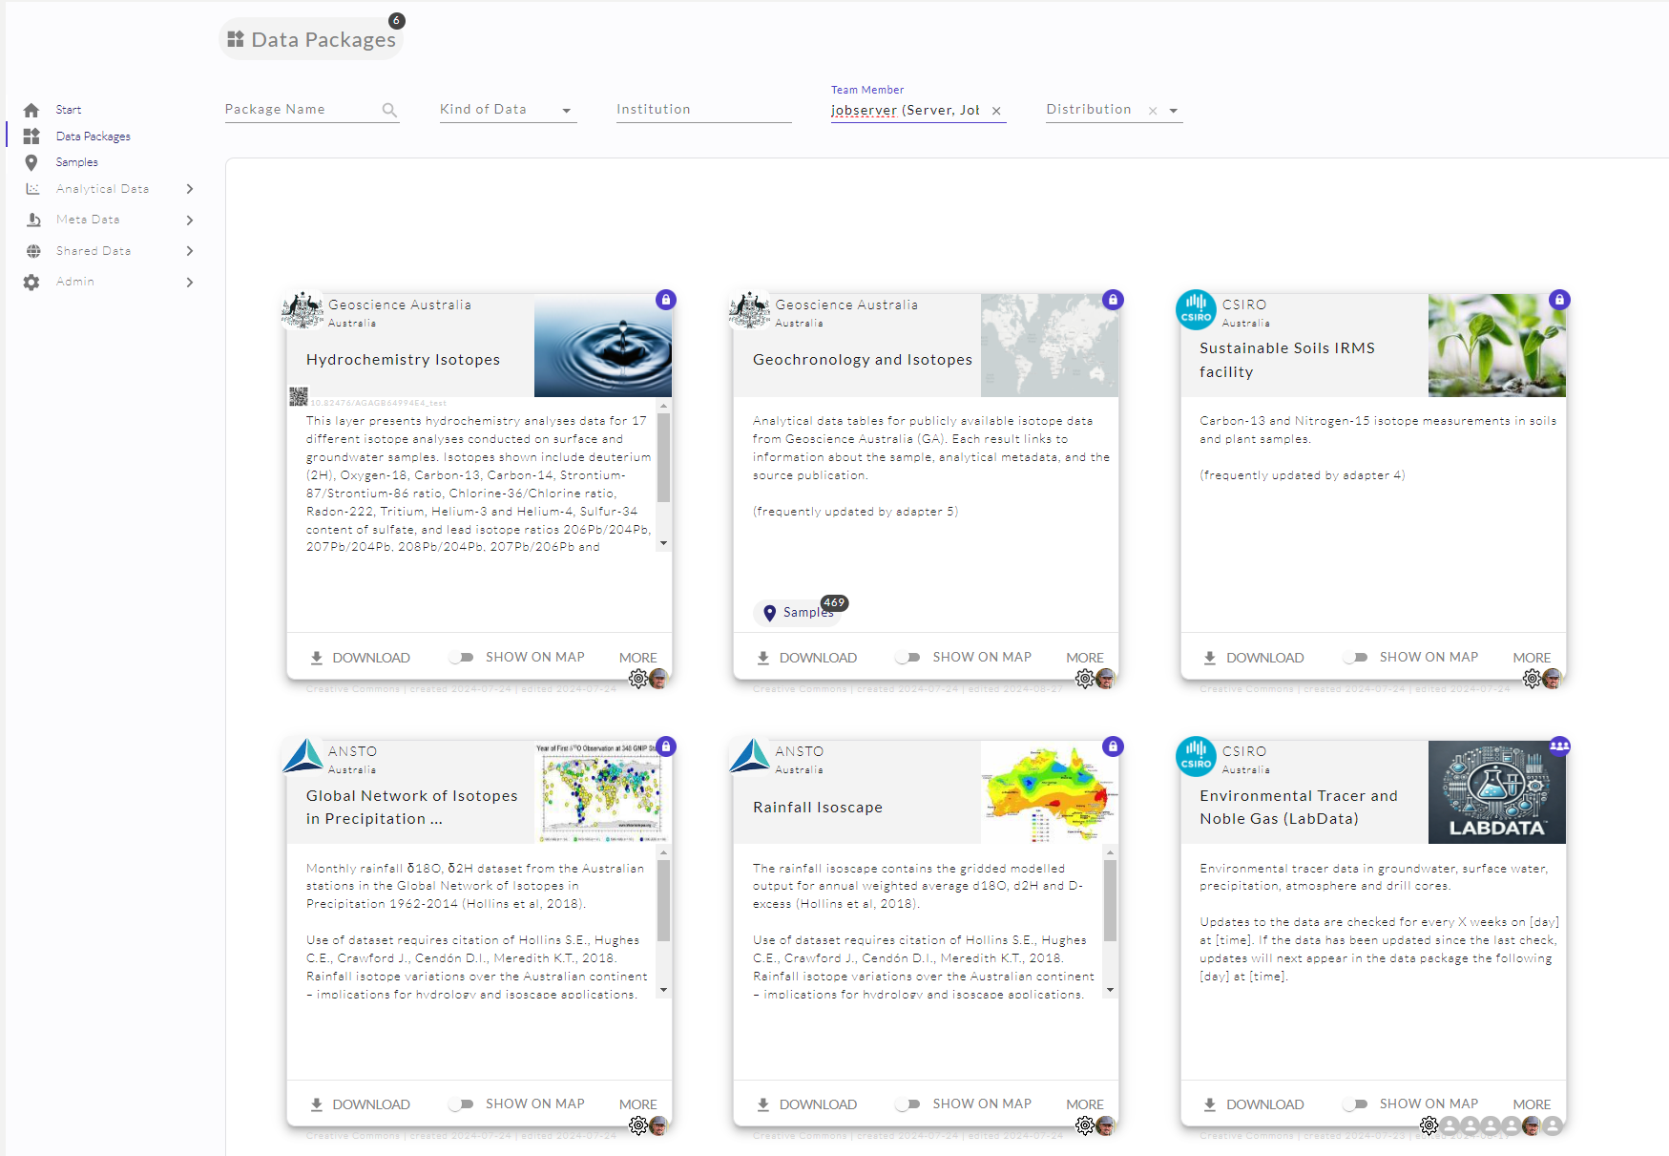
Current State
Technically Working
Ready for Production

Slide 3
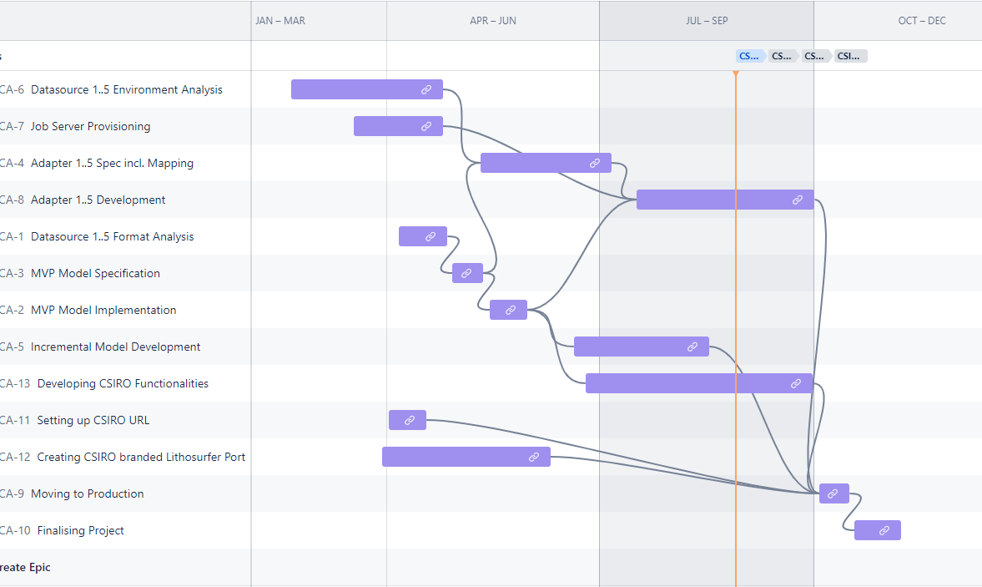
Lithodat internal Timeline

Slide 4
Lithodat internal Timeline
Adapter 3

Slide 5
Feedback
Example for Feedback on Adapter 3
SAMPLE_TYPE Mappings needs specification
…
Adapter 3

Slide 6
Lithodat internal Timeline
Adapter 3
A. 5
A. 6
A. 2
A. 4
A. 1

Slide 7
Lithodat internal Timeline

Slide 8
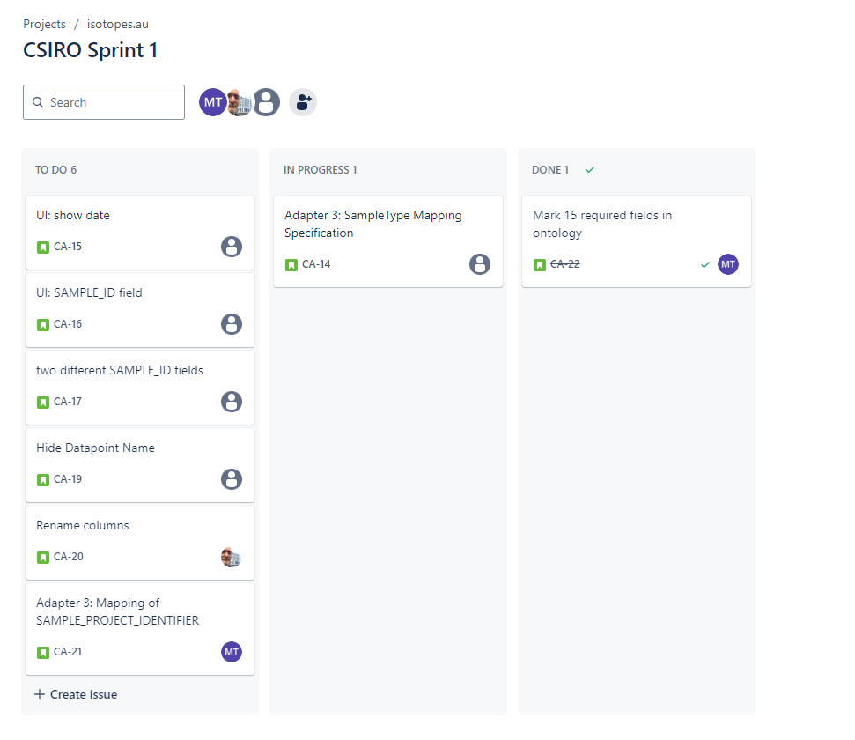
All Feedback and Issues can be managed in Jira

Slide 9
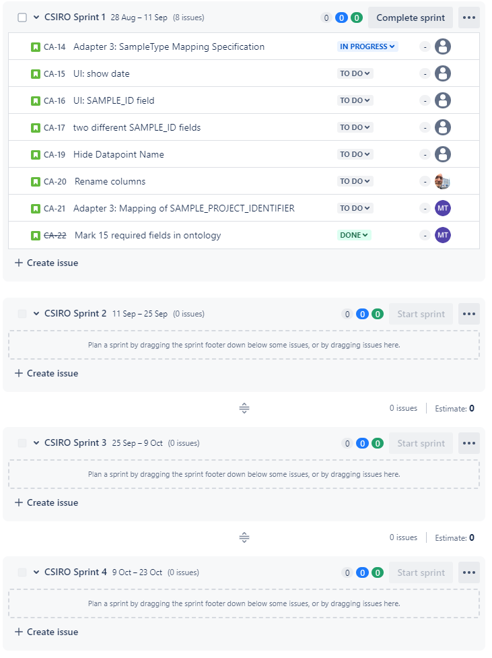
There is time for about 4 two week sprints

Slide 10
Thanks!

Slide 11
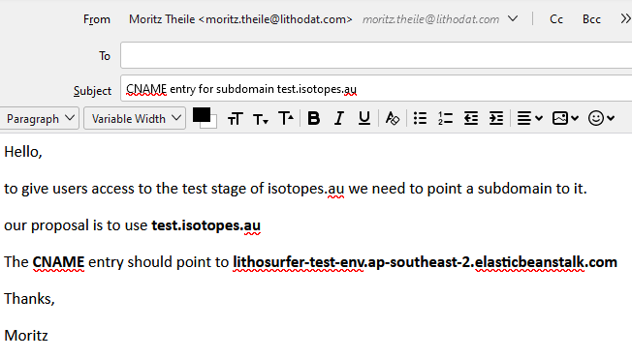
Send Mails with instructions
Who are the recipients?

